Slide 1
Game objects and animation
Created by Jayson McCune

Slide 2
objectives
Displaying images with canvas
How to make objects
Making copies of objects
Object states
Timed state changes
Animation

Slide 3
Displaying images with canvas
Canvas is an html tag that can display images
It can be used to display and render animation and images quickly
Canvas displays images in a context
Context can be 2D or 3D

Slide 4
Displaying images with canvas
Use the html canvas tag
Get a reference to the tag in JavaScript
Get a reference to the drawing surface
Create an image variable to hold the new image

Slide 5

Displaying images with canvas
Add a listener to render the image when the image has loaded
Assign the src property to the image that you want to load

Slide 6
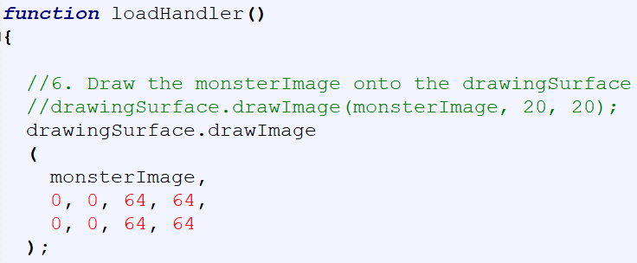
Displaying images with canvas
Create the function to draw the image when the image tag is loaded
drawImage method takes several arguments. The arguments are image name, x, y, height, width, x, y, height, width. The first x, y, height and width are from the source image. The second set is the destination location in canvas.

Slide 7

How to make objects
Object is a self contained model of something useful in your game
Every object has properties that describe the object
Create an object with curly brackets and the creation of properties inside the brackets.

Slide 8


How to make objects
Access an objects properties by using the object name, then a dot, then the property you want to access.
Change the property with an assignment equal sign.

Slide 9


How to make objects
Make the object declaration easier to read by formatting it like this.
You can also create an object using this format.

Slide 10
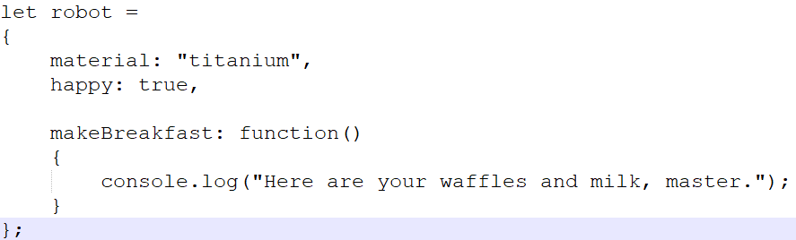
How to make objects
You can also add methods or functions to an object.

Slide 11
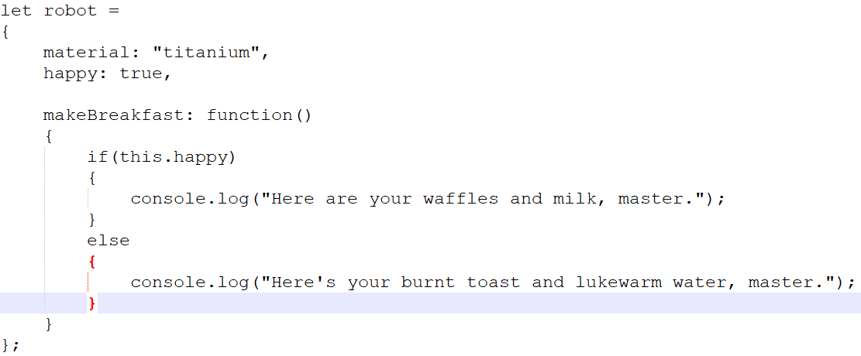
How to make objects
Reference properties inside object function with the key word this.

Slide 12
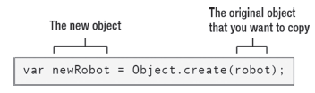
Making copies of objects
Use Object.create() to create a copy of an object.
If you use an assignment (=) operator it will have the two variables pointing to the same object and will not create a new object. DON’T DO THIS

Slide 13


Add new properties and methods
To add properties and methods use the dot notation and then the new property or method name
You can add a method to only one object instead of all of them

Slide 14


Looping through objects
Use for loop to loop through an object’s properties and methods
To find a specific property

Slide 15
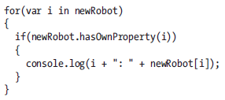
Find a property
Use hasOwnProperty to find properties that are original to the specific object

Slide 16
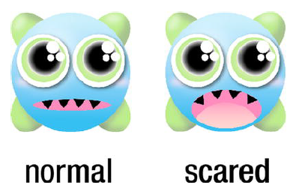
Object states
State is a form of existence
Can use a variable inside the object to keep track of its state
Sword object could have two states, dull and sharp
Monster object two states

Slide 17
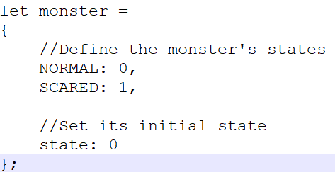
Object states
Simplified monster object, scared = 1 normal = 0
Display initial state

Slide 18
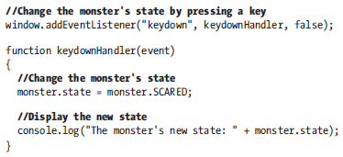
Object states
Change the state with a keyboard press

Slide 19

Display states with canvas
A single file image contains both monster states
Each monster image state is 64 pixels wide
The whole image file is 128 pixels wide

Slide 20


Display states with canvas
Use the drawImage method to selectively display the correct section of the image
Normal state of the monster uses the first section of the image
Scared state of the monster uses the second section of the image

Slide 21
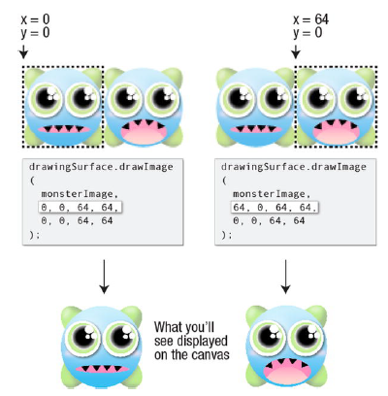
Display states with canvas
See the example code in Canvas

Slide 22

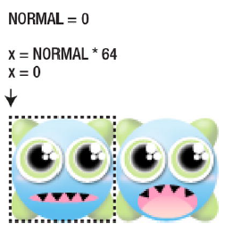
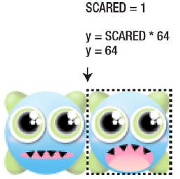
Display states with canvas
Can use math instead of switch to display the proper state

Slide 23


Timed state changes
window.setTimeout
Allows something to be ran after a certain amount of time
window.setInterval
Allows something to be ran in a continuously ran loop

Slide 24
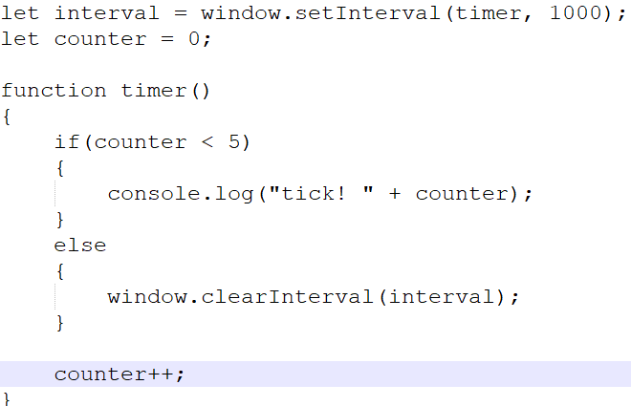
Timed state changes
window.clearInterval allows you to stop a setInterval loop

Slide 25
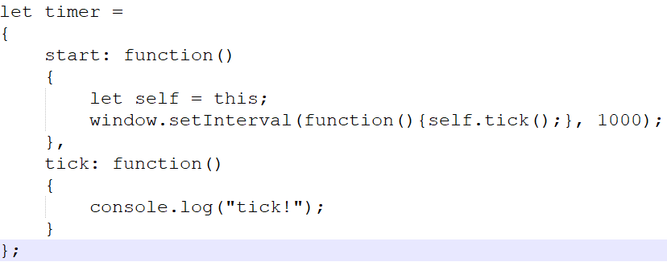
Timed state changes
Timer object
Need to call the timer.start() function to run

Slide 26
Monster state change timer
See code example on Canvas

Slide 27

animation
To simulate animation use multiple images, called frames, then show them on the screen in quick succession. Our brain will blur them together into an animated image
All the frames of the animation will be in one image that is called a tilesheet
Use the timer, canvas, and display image to create the animation out of the tilesheet

Slide 28
animation
Will use the tilesheet to create the animation with a timer
See the code example on Canvas

